Slide 1

History of Quantum Mechanics
-Introduction
Quantum Mechanics emerged in the early 20th century.
It explained experimental results that classical physics could not.
It revolutionized physics by introducing a) probabilistic interpretations, b) wave–particle duality, and c) quantization of energy.

Slide 2
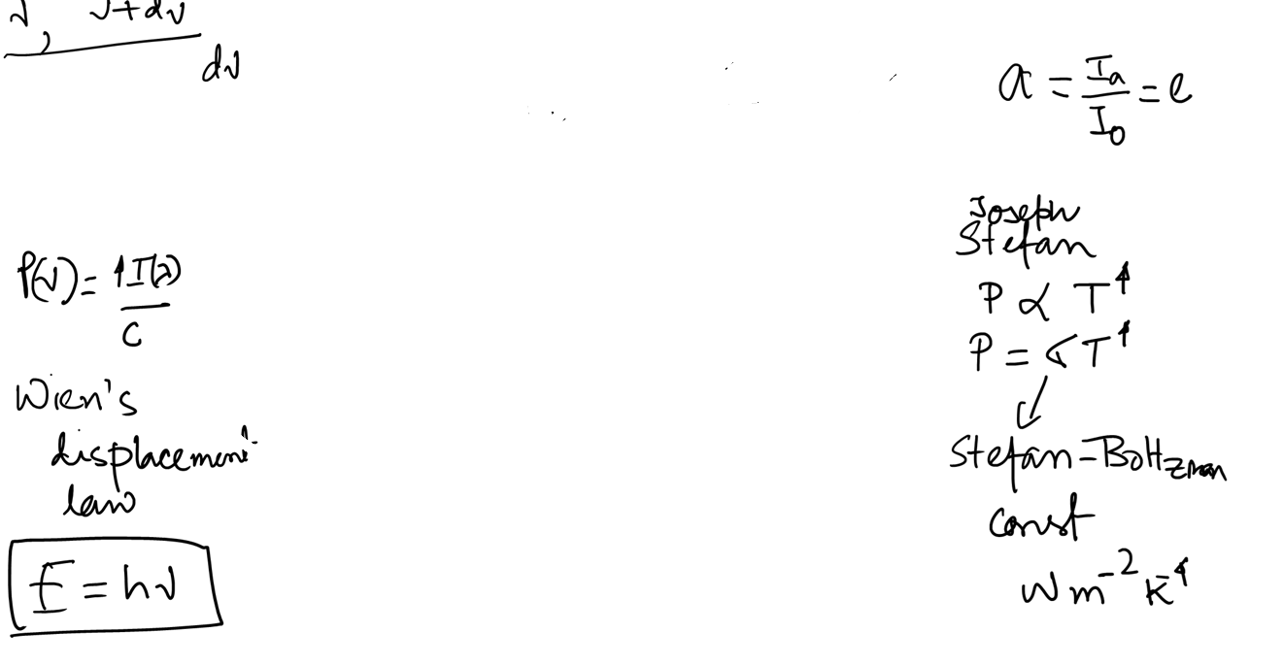
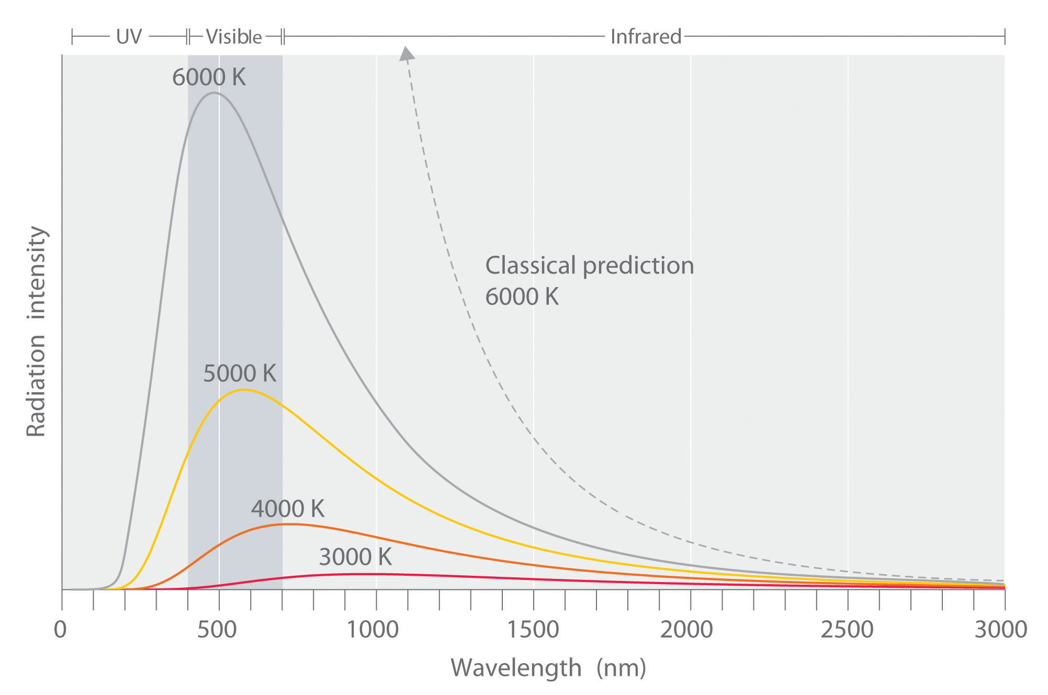
The Crisis of classical Physics –Late 19th Century
(a) Blackbody Radiation
Classical prediction (Rayleigh–Jeans Law) led to the ultraviolet catastrophe.
Experimental results showed energy distribution peaked and then declined at high frequencies.

Slide 3
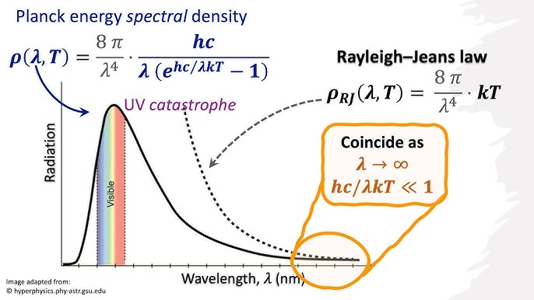
https://chem.libretexts.org/Courses/DePaul_University/Thermodynamics_and_Introduction_to_Quantum_Mechanics_(Southern)/07%3A_The_Development_of_Quantum_Mechanics/7.01%3A_Blackbody_Radiation

Slide 4

(b) Photoelectric Effect
Light shining on metal ejects electrons.
Classical theory predicted energy depends on intensity.
Experiments showed energy depends on frequency.

Slide 5
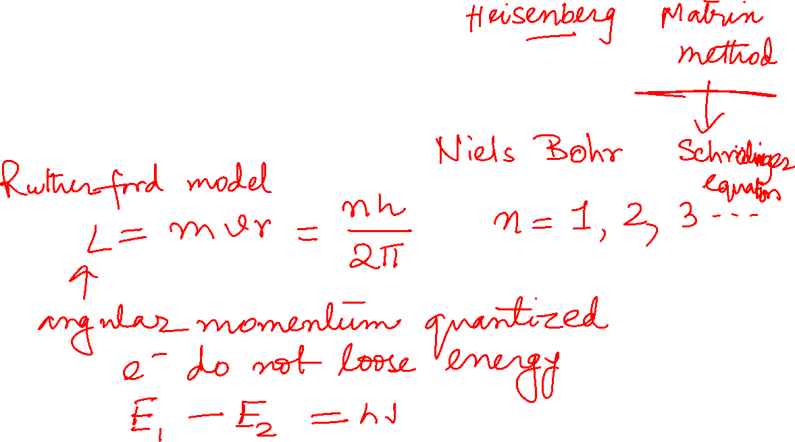
(c) Atomic Stability
According to classical electrodynamics, orbiting electrons should radiate energy and collapse into the nucleus.
Atoms are stable — contradiction.

Slide 6
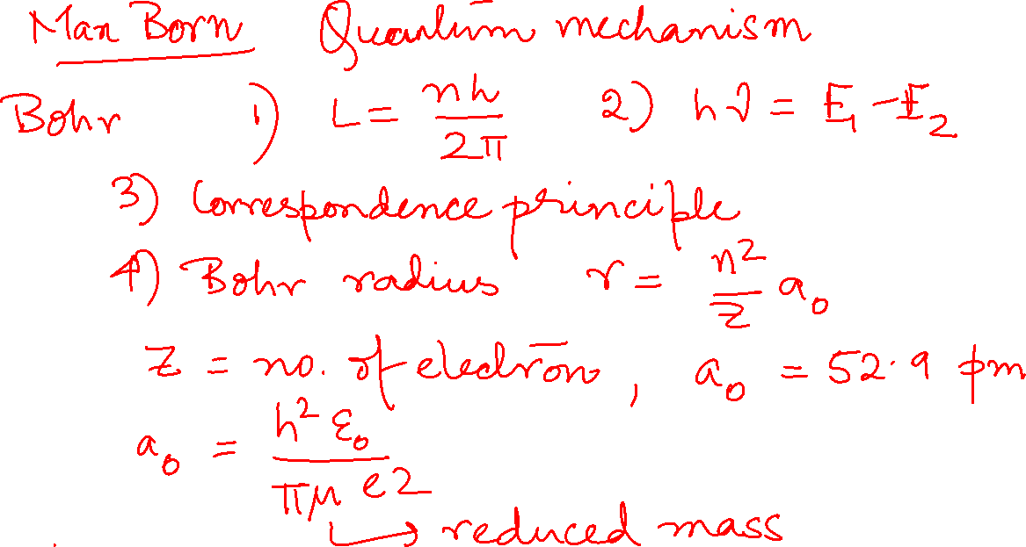

Slide 7

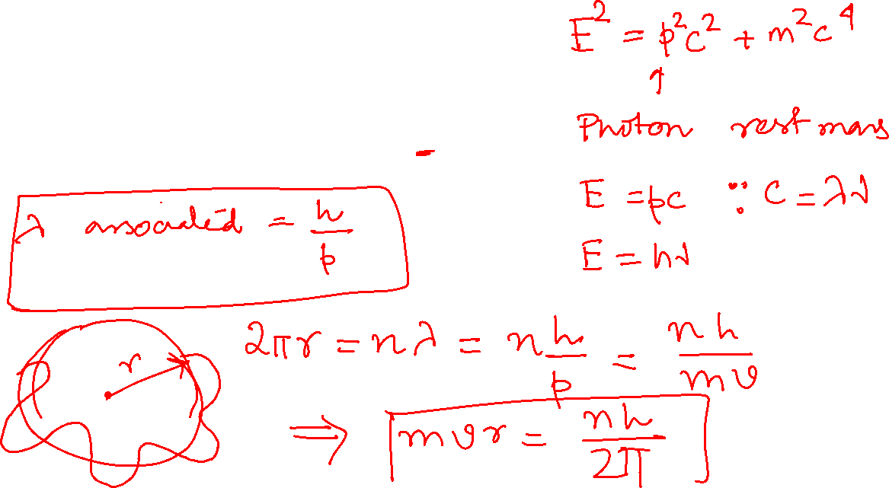
Wave–Particle Duality (1920s)
Louis de Broglie (1924)
Proposed matter has wave properties.
Wavelength formula:
$$λ=\frac{h}{p}$$
Confirmed experimentally in electron diffraction.

Slide 8
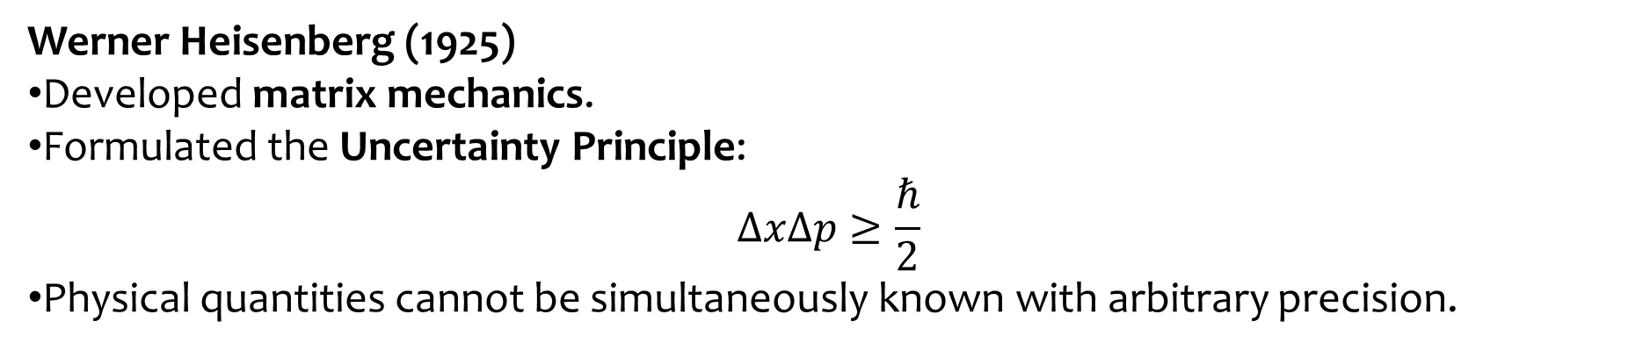
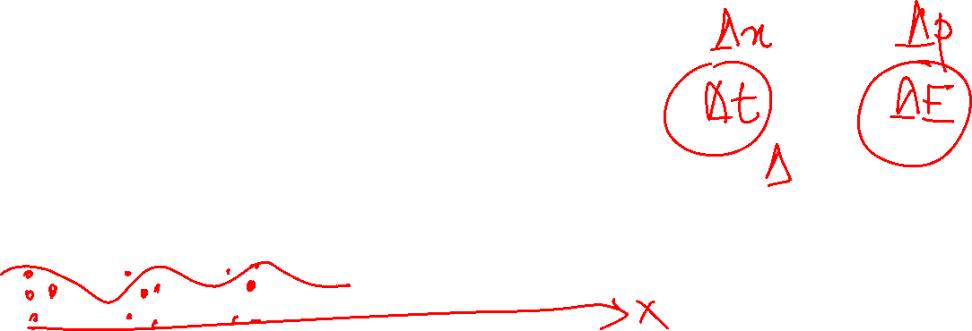
Werner Heisenberg (1925)
Developed matrix mechanics.
Formulated the Uncertainty Principle:
$$ΔxΔp≥\frac{ℏ}{2}$$
Physical quantities cannot be simultaneously known with arbitrary precision.

Slide 9
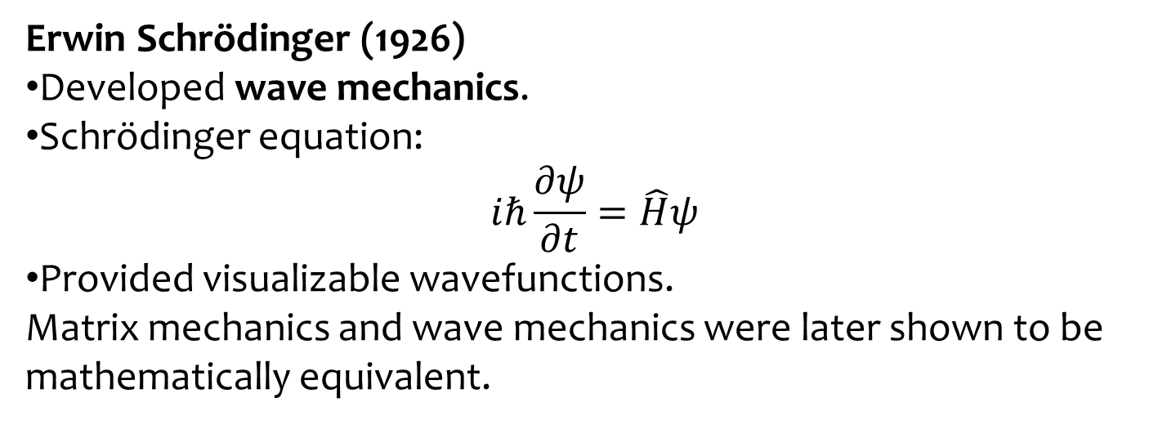
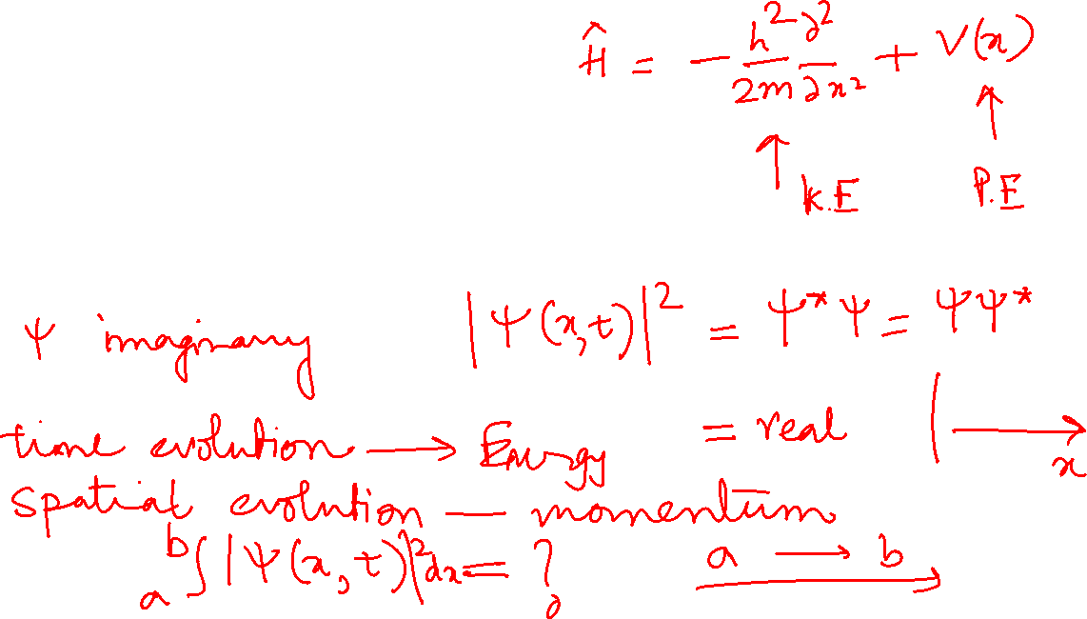
Erwin Schrödinger (1926)
Developed wave mechanics.
Schrödinger equation:
$$iℏ\frac{∂ψ}{∂t}=\hat{H}ψ$$
Provided visualizable wavefunctions.
Matrix mechanics and wave mechanics were later shown to be mathematically equivalent.

Slide 10
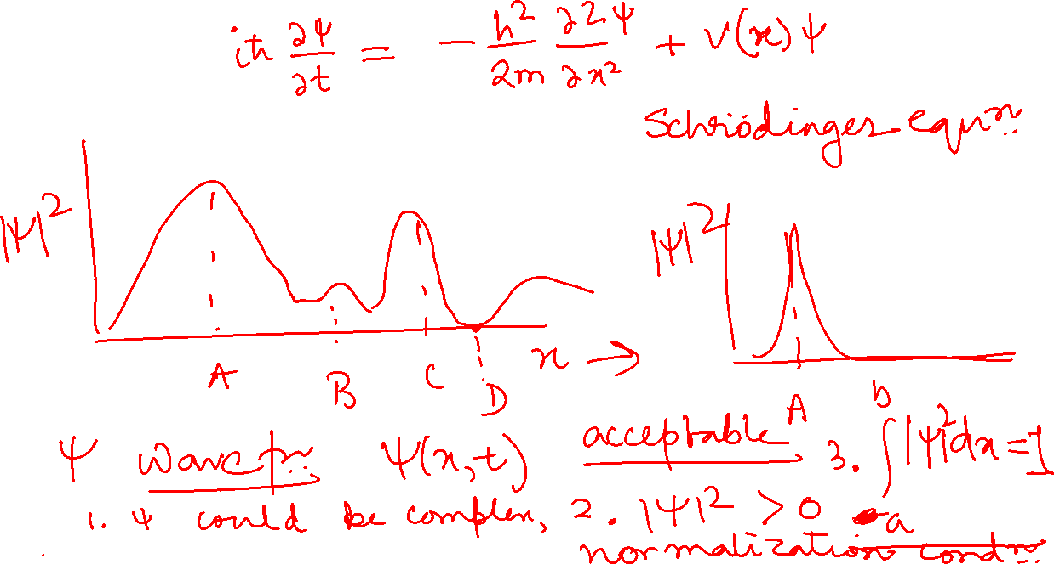

Slide 11
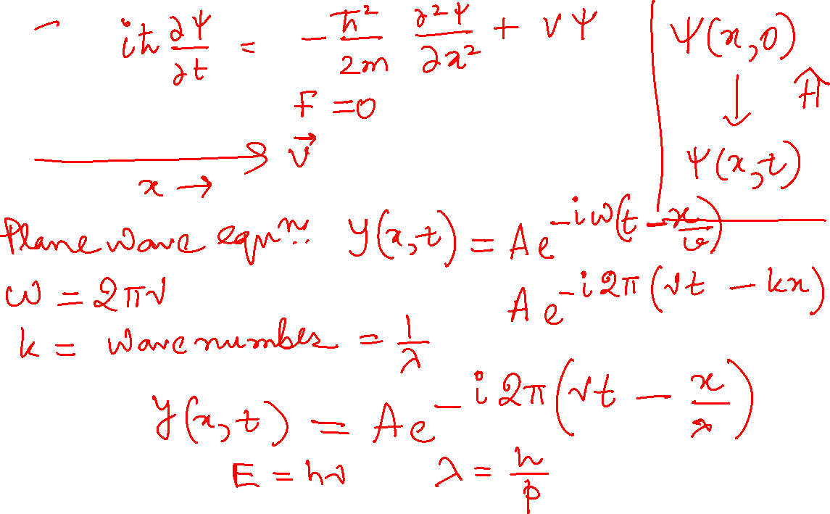

Slide 12
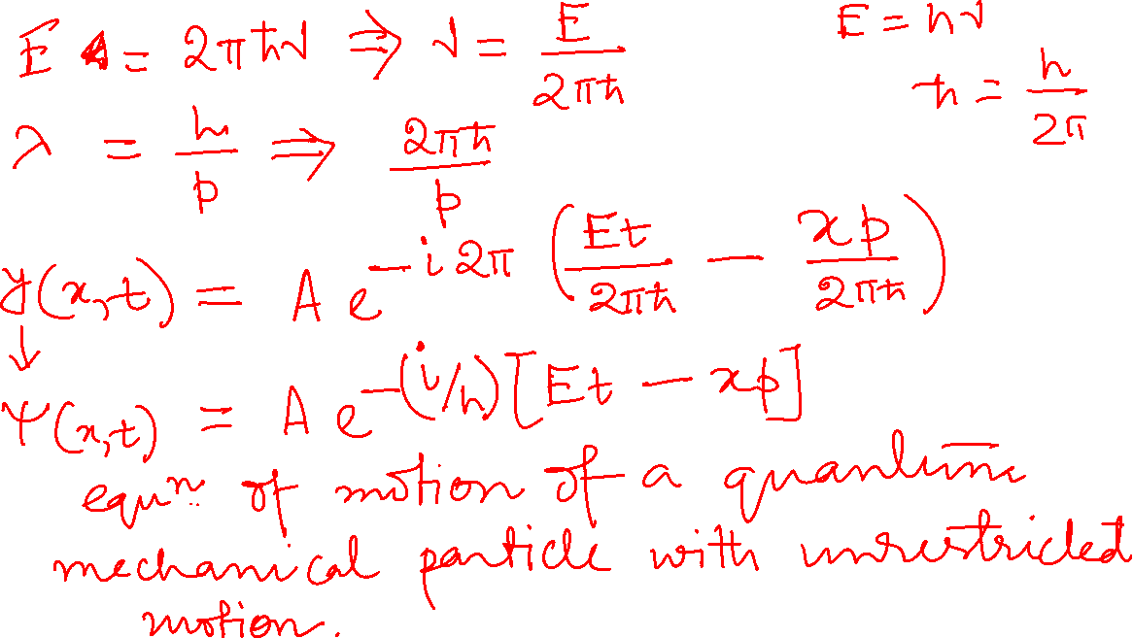

Slide 13
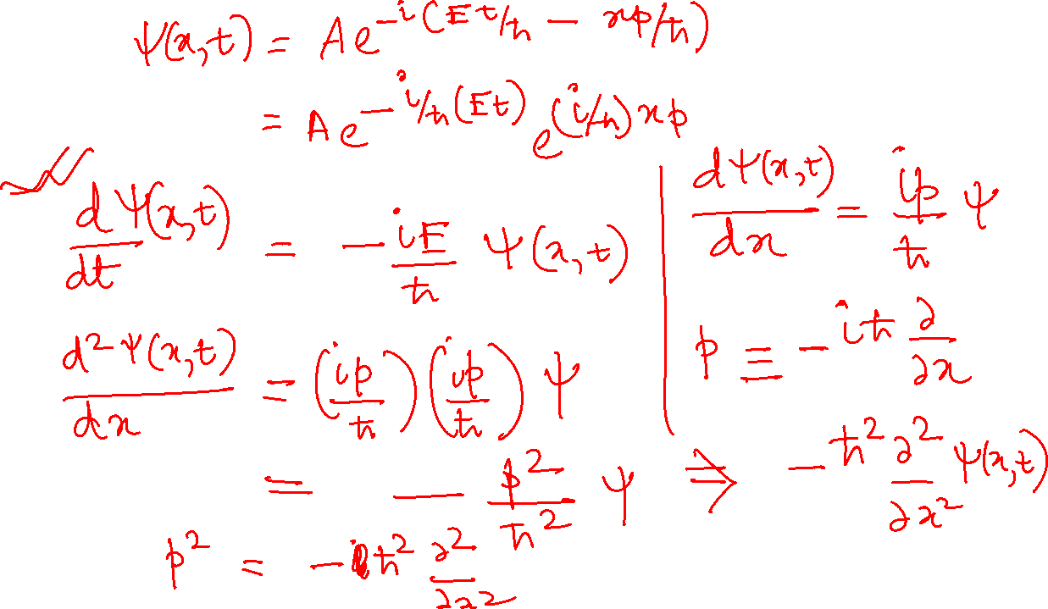

Slide 14

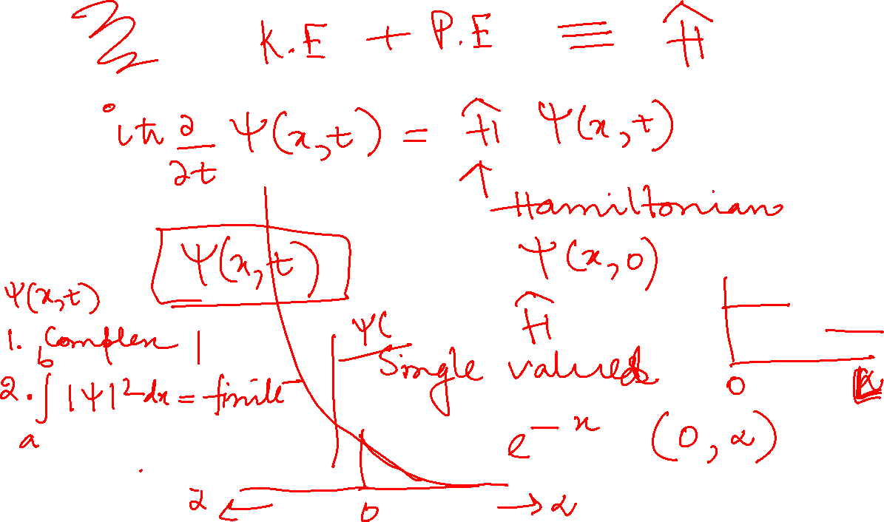

Slide 15
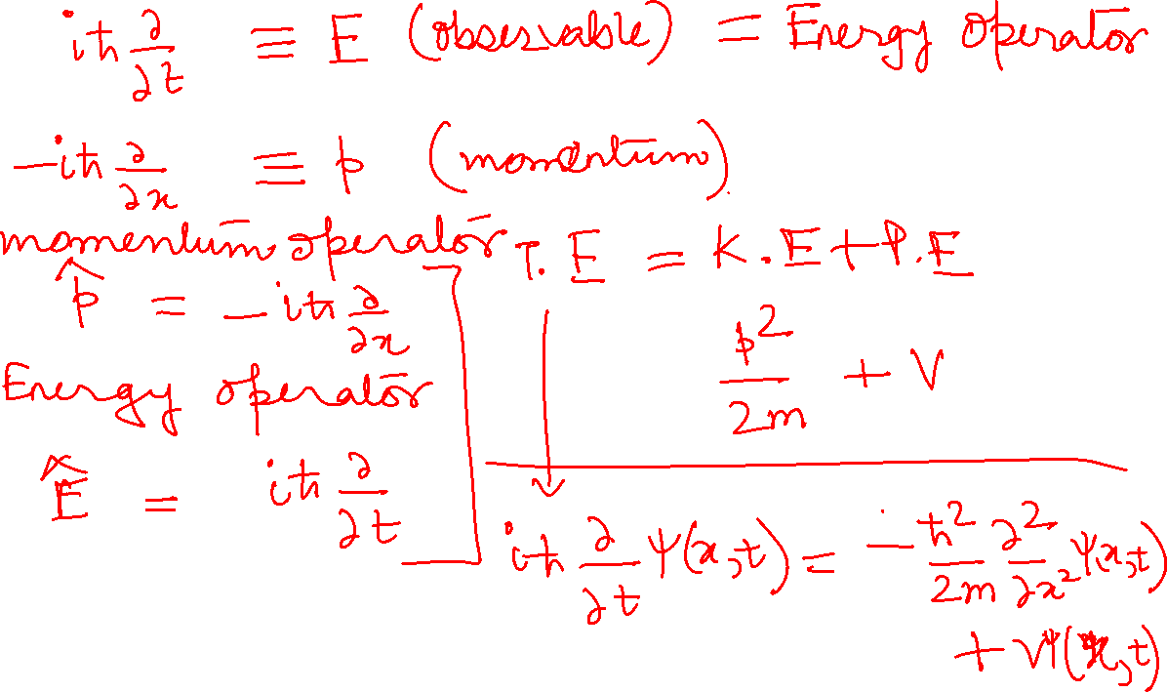

Slide 16
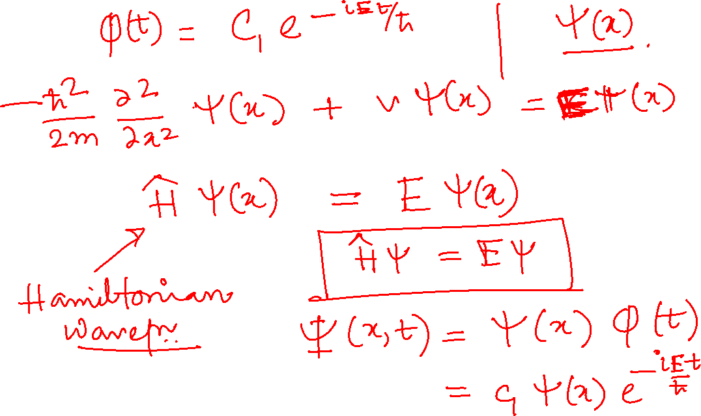

Slide 17
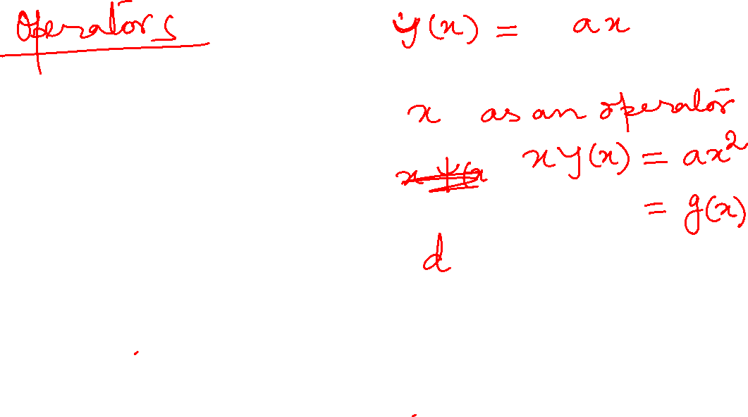
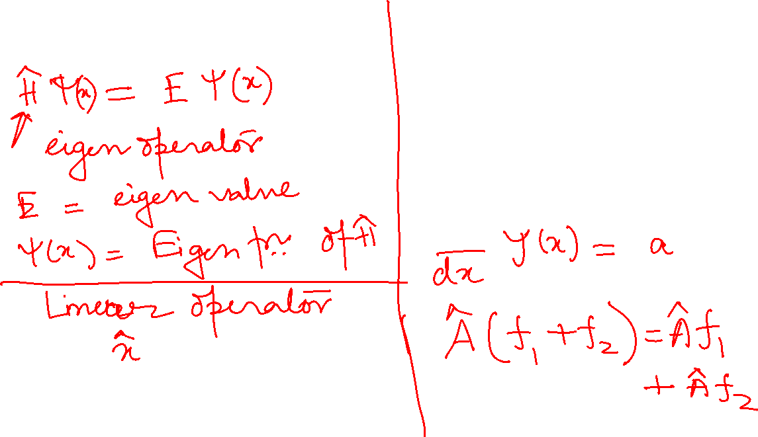

Slide 18
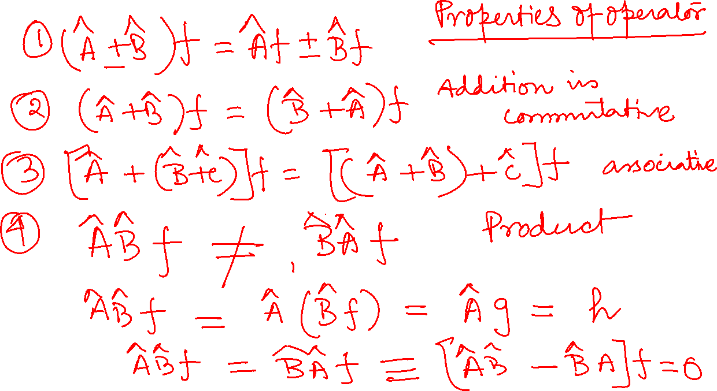

Slide 19
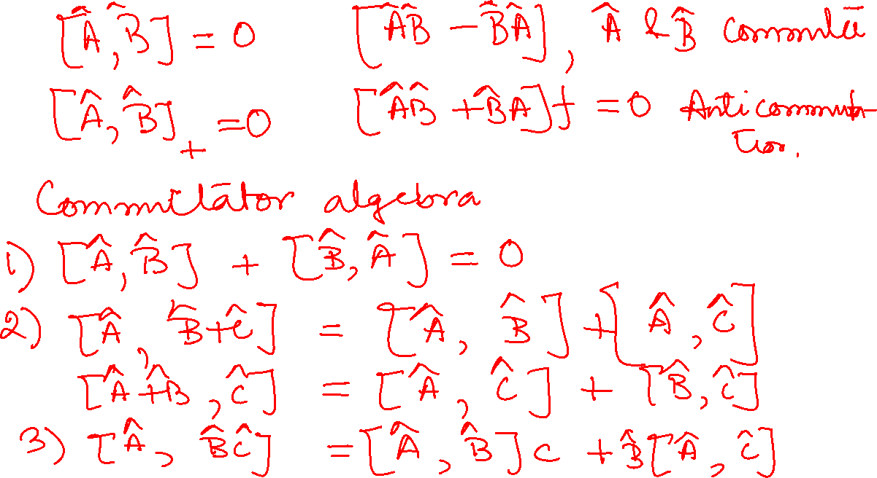

Slide 20
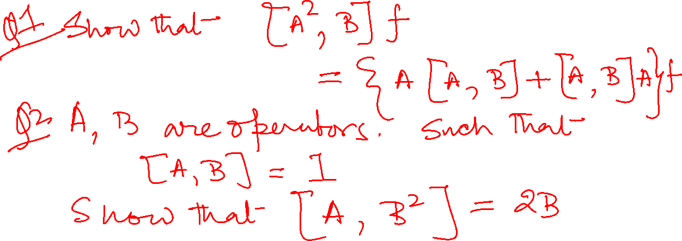

Slide 21
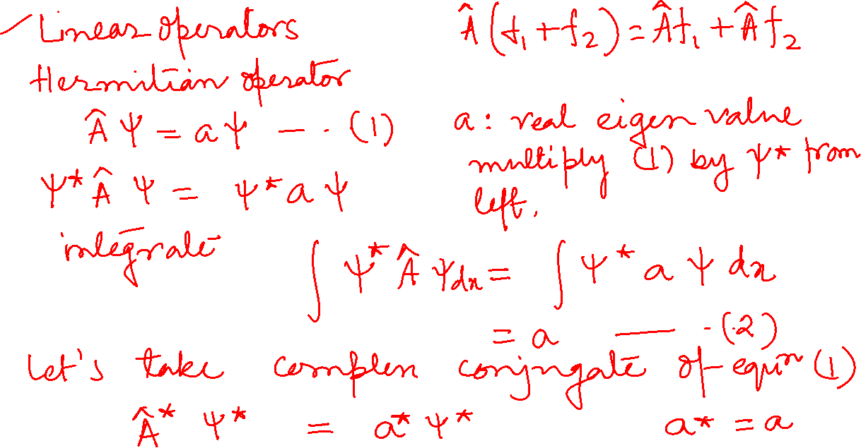

Slide 22
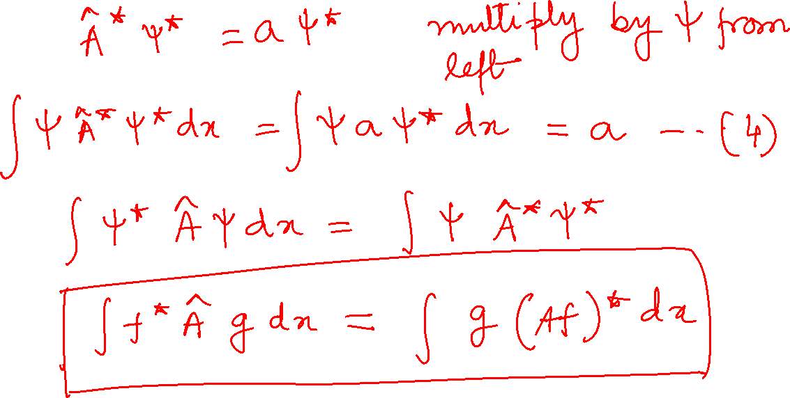

Slide 23
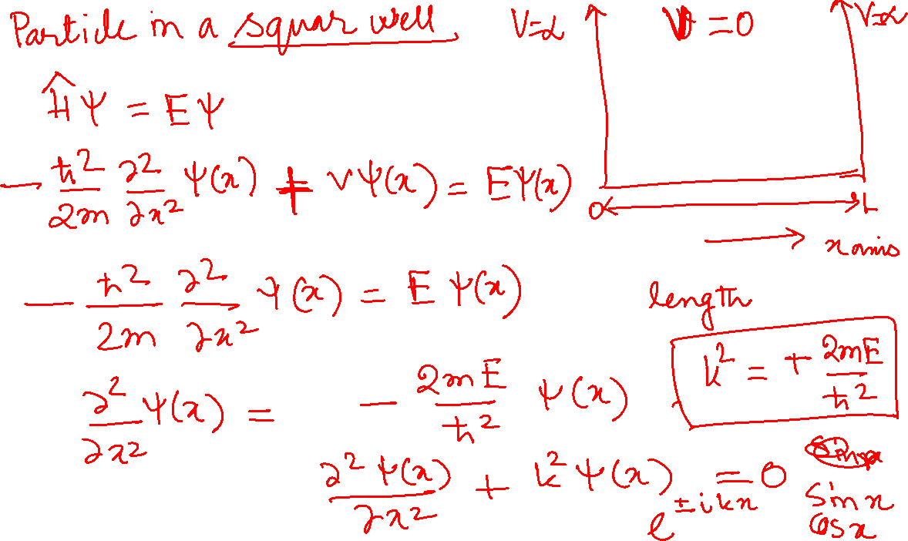

Slide 24
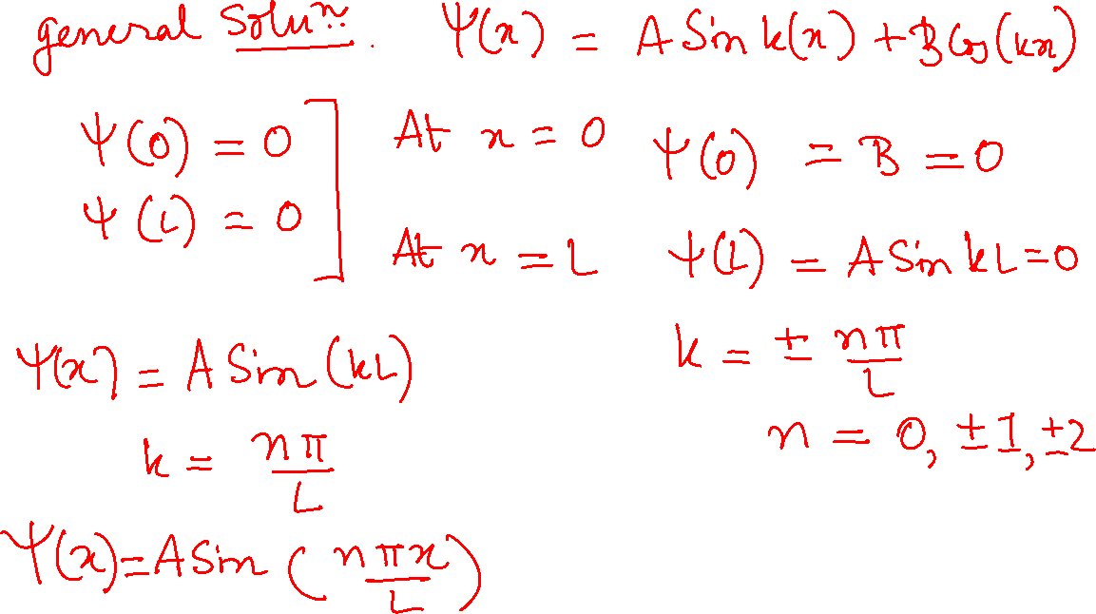

Slide 25
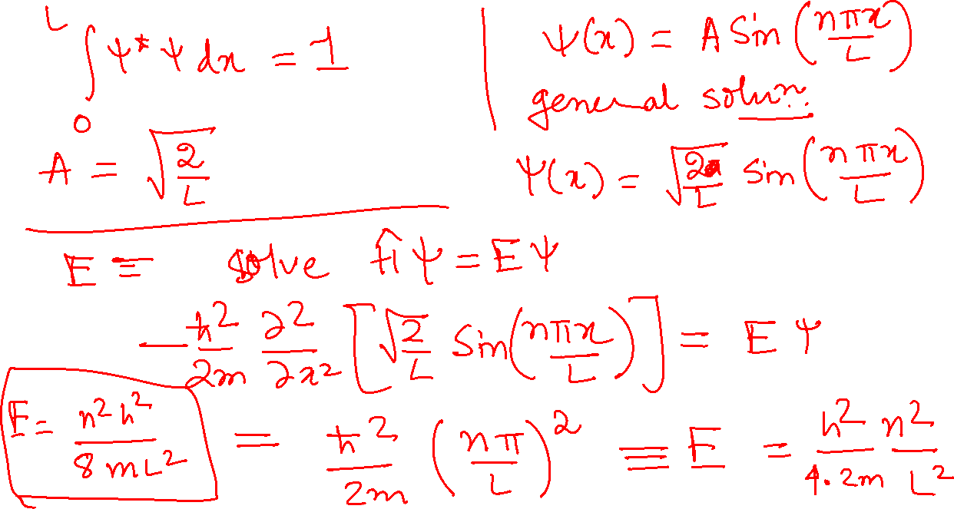

Slide 26
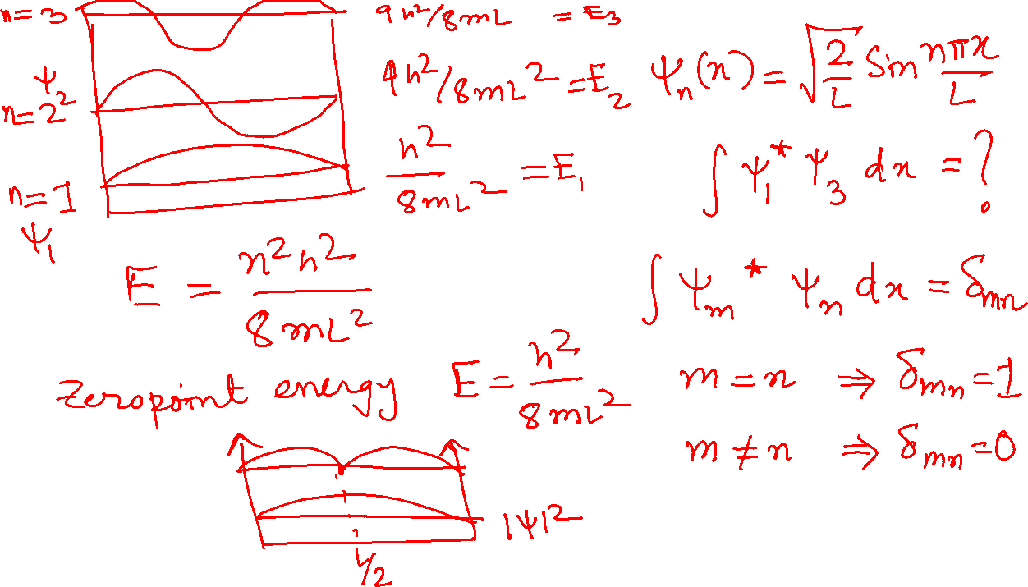

Slide 27
